Slide 1
DICYCAT: KROY
User Manual

Slide 2
CONTENTS
Introduction … 3
Controls … 4
Menu Navigation … 5
Options … 6
Aim of the Game … 7
Navigating the Map … 8

Slide 3
INTRODUCTION
The year is 2042 and York has been invaded by evil extraterrestrials (ETs) from planet Kroy, who have set up fortresses in key locations (e.g. York Minster, Clifford Tower) around the city. While ETs are more technologically advanced and outgun humans, they have a major - and very convenient - weakness: they evaporate when they come in contact with water. As the leader of the Resistance, you have taken over York's old Fire Station and you are now in control of its fire engines. Your mission is to use the fire engines you control to flood the ET fortresses, and liberate York.

Slide 4
CONTROLS
Menu
Drive Forward
Drive Backward
Drive Left
Drive Right
Select Fire truck
The control scheme is very simple, making use of the arrow keys for movement and the escape key to enter the in-game menu.
P
ESC
M
V
V
V
V
1
2
3
4

Slide 5

Fire Truck Specs
There are four fire trucks to choose from in the game.
1- Increased Speed 2 - Increased Damage 3 - Increased Capacity 4 - Increased Range

Slide 6
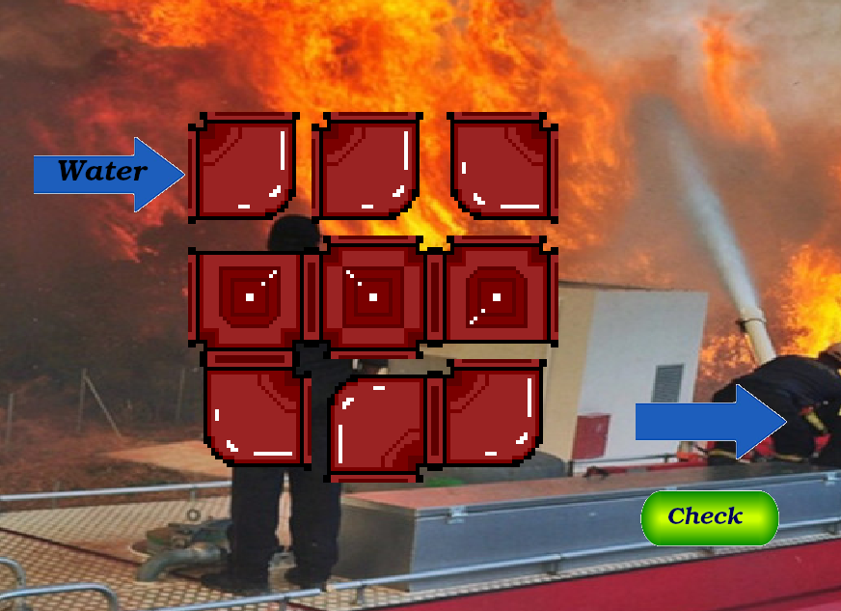
Minigame
When a truck needs refilling with water, visit the fire station and have a chance to play the minigame!
You’ll either automatically get filled up or you’ll be taken to play the game before being refilled.
If you can turn the pipes to allow the water to flow through from start to end, you’ll be rewarded with a full tank of water!
However, if you fail you will not be able to return to the game until you succeed!

Slide 7
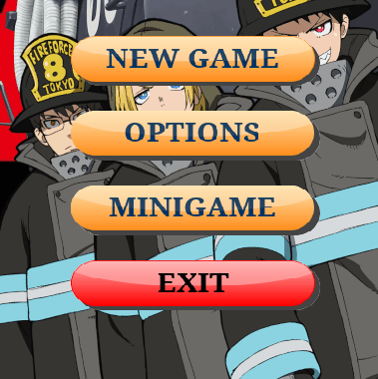
MENU NAVIGATION
On the main menu there are four buttons:
New Game: begins a new game of Kroy, and allows you to choose your desired truck with which to play the game with.
Options: takes you through to the options menu(s), allowing you to tweak and change the settings for the game such as volume and enabling/disabling music.
Minigame: launches the minigame.
Exit: closes the game/application.
How to navigate the in-game menus.

Slide 8
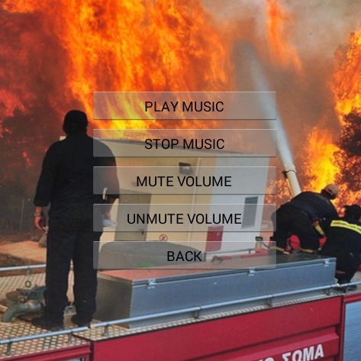
OPTIONS
On the options menu when you are playing a game, there are 3 buttons to choose from:
Resume: exits the menu and returns to the game.
Menu: takes you to the options menu (see below**).
Exit: closes the game/application.
On the options menu** there are 5 buttons:
Play/Stop Music: either enables or disables the background music.
Mute/Unmute Volume: either enables or disables all game sounds.
Back: returns you back to the main options page.
How to change the options in-game.

Slide 9
AIM OF THE GAME
Drive your fire engine around the map using the arrow keys.
Get close to ET fortresses and your truck will automatically shoot water at them.
ET fortresses will be destroyed once you have shot enough water at them.
Avoid the projectiles shot by the fortresses.
The blue bar above your truck shows how much water you have in your tank.
Return to the fire station (see map) in order to refill your tank with water.
You will be returned to the fire station automatically when your truck is destroyed. You only have 4 trucks, so be careful!

Slide 10
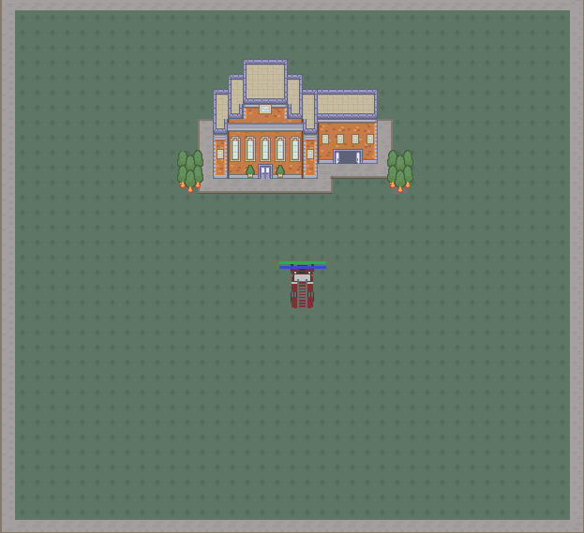
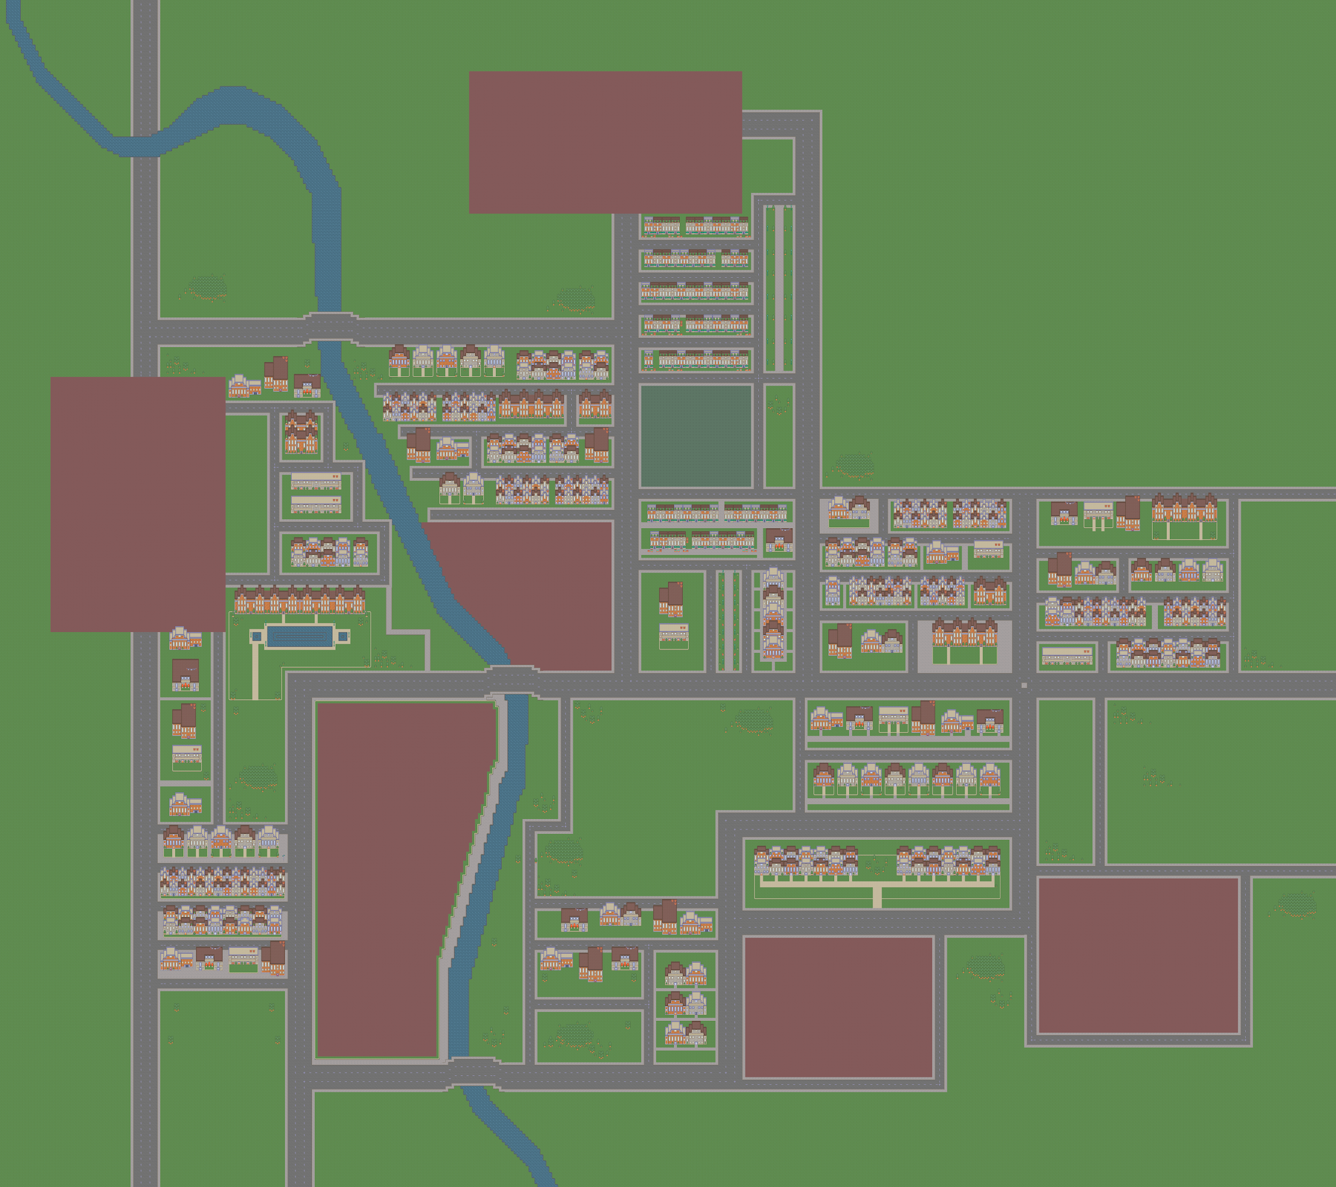
NAVIGATING THE MAP
This is the map, based on the city of York.
Drive on roads, grass and dirt, but you will not be able to drive through buildings, structures or rivers.
The fire station is your base of operations. Return here in your truck in order to refill your water tank.
There is a mini map in the bottom left of the screen showing fortresses, firetrucks and alien patrols to help navigation.

